Slide 1
Module 3: Digital Systems

Slide 2


1. Number systems

Slide 3



Number system
In digital electronics, the number system is used for representing the information.
The number system has different bases and the most common of them are the decimal, binary, octal, and hexadecimal.
The base of the number system is the total number of the digit used in the number system.
Suppose if the number system representing the digit from 0 – 9 then the base of the system is the 10.

Slide 4
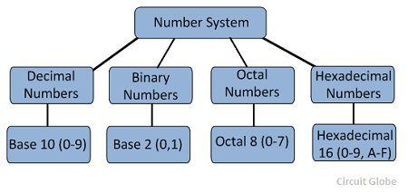




Types of Number Systems
Some of the important types of number system are
Decimal Number System
Binary Number System
Octal Number System
Hexadecimal Number System

Slide 5

Decimal Number Systems
The number system is having digit 0, 1, 2, 3, 4, 5, 6, 7, 8, 9; this number system is known as a decimal number system because total ten digits are involved.
The base of the decimal number system is 10.

Slide 6



Binary Number Systems
Decimal | Binary
0 | 0000
1 | 0001
2 | 0010
3 | 0011
4 | 0100
5 | 0101
6 | 0110
7 | 0111
8 | 1000
9 | 1001
10 | 1010
11 | 1011
12 | 1100
13 | 1101
14 | 1110
15 | 1111
The modern computers do not process decimal number; they work with another number system known as a binary number system which uses only two digits 0 and 1.
The base of binary number system is 2 because it has only two digit 0 and 1.
The digital electronic equipment's are works on the binary number system and hence the decimal number system is converted into binary system.

Slide 7
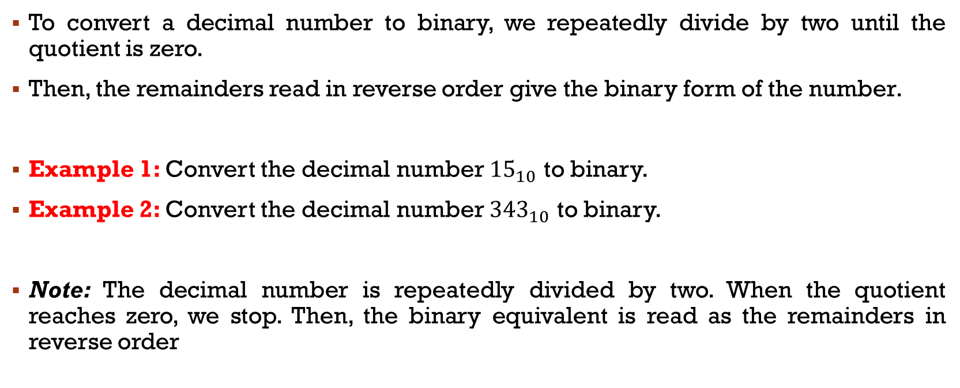


Conversion of Decimal number to Binary Form
To convert a decimal number to binary, we repeatedly divide by two until the quotient is zero.
Then, the remainders read in reverse order give the binary form of the number.
Example 1: Convert the decimal number ${15}_{10}$ to binary.
Example 2: Convert the decimal number ${343}_{10}$ to binary.
Note: The decimal number is repeatedly divided by two. When the quotient reaches zero, we stop. Then, the binary equivalent is read as the remainders in reverse order

Slide 8

Conversion of Binary to decimal Form
Example 3: Convert the binary number ${1101}_{2}$ in the decimal form

Slide 9

Octal Numbers
Decimal | Binary | Octal
0 | 0000 | 0
1 | 0001 | 1
2 | 0010 | 2
3 | 0011 | 3
4 | 0100 | 4
5 | 0101 | 5
6 | 0110 | 6
7 | 0111 | 7
8 | 1000 | 10
9 | 1001 | 11
10 | 1010 | 12
11 | 1011 | 13
12 | 1100 | 14
13 | 1101 | 15
14 | 1110 | 16
15 | 1111 | 17
The base of a number system is equal to the number of digits used, i.e., for decimal number system the base is ten while for the binary system the base is two.
The octal system has the base of eight as it uses eight digits 0, 1, 2, 3, 4, 5, 6, 7.
All these digits from 0 to 7 have the same physical meaning as by decimal symbols, the next digit in the octal number is represented by 10, 11, 12, which are equivalent to decimal digits 8, 9, 10 respectively.

Slide 10
Hexadecimal Numbers
Decimal | Binary | Octal | Hexadecimal
0 | 0000 | 0 | 0
1 | 0001 | 1 | 1
2 | 0010 | 2 | 2
3 | 0011 | 3 | 3
4 | 0100 | 4 | 4
5 | 0101 | 5 | 5
6 | 0110 | 6 | 6
7 | 0111 | 7 | 7
8 | 1000 | 10 | 8
9 | 1001 | 11 | 9
10 | 1010 | 12 | A
11 | 1011 | 13 | B
12 | 1100 | 14 | C
13 | 1101 | 15 | D
14 | 1110 | 16 | E
15 | 1111 | 17 | F
These numbers are used extensively in microprocessor work.
The hexadecimal number system has a base of 16, and hence it consists of the following sixteen number of digits.
0, 1, 2, 3, 4, 5, 6, 7, 8, 9, A, B, C, D, E, F.

Slide 11


Converting Octal and Hexadecimal to Binary
Decimal | Binary | Octal | Hexadecimal
0 | 0000 | 0 (000) | 0 (0000)
1 | 0001 | 1 (001) | 1 (0001)
2 | 0010 | 2 (010) | 2 (0010)
3 | 0011 | 3 (011) | 3 (0011)
4 | 0100 | 4 (100) | 4 (0100)
5 | 0101 | 5 (101) | 5 (0101)
6 | 0110 | 6 (110) | 6 (0110)
7 | 0111 | 7 (111) | 7 (0111)
8 | 1000 | 10 | 8 (1000)
9 | 1001 | 11 | 9 (1001)
10 | 1010 | 12 | A (1010)
11 | 1011 | 13 | B (1011)
12 | 1100 | 14 | C (1100)
13 | 1101 | 15 | D (1101)
14 | 1110 | 16 | E (1110)
15 | 1111 | 17 | F (1111)

Slide 12
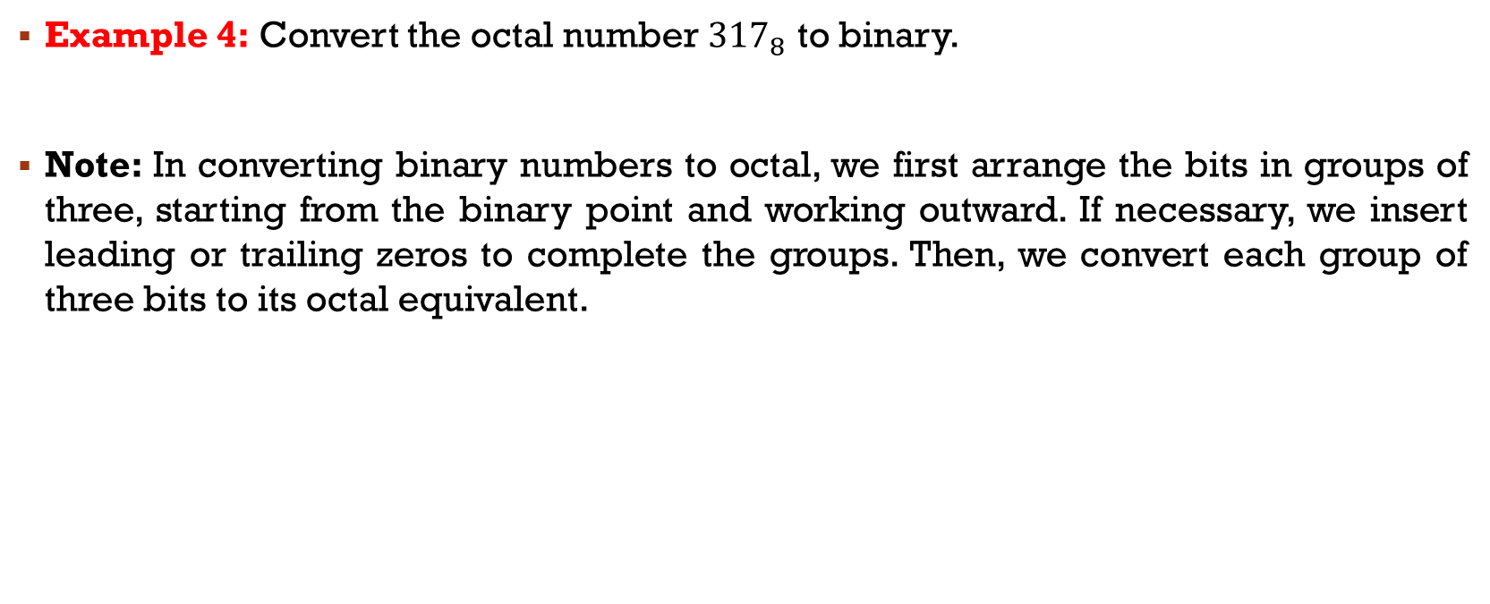

Converting Octal to Binary
Example 4: Convert the octal number ${317}_{8}$ to binary.
Note: In converting binary numbers to octal, we first arrange the bits in groups of three, starting from the binary point and working outward. If necessary, we insert leading or trailing zeros to complete the groups. Then, we convert each group of three bits to its octal equivalent.

Slide 13

Convert Hexadecimal Numbers to Binary
Example 5: Convert the hexadecimal number ${F3A}_{16}$ to binary
Note: Conversion to hexadecimal uses the same approach, except that the binary number is arranged in groups of four bits.

Slide 14
Converting Binary Numbers to Octal or Hexadecimal
Example 6: Convert 11110110 to octal and to hexadecimal.
Note: For conversion to octal, we first form three-bit groups, working outward from the binary point. Notice that we have appended leading and trailing zeros so that each group contains three bits. Next, we write the octal digit for each group.
Note: For conversion to hexadecimal, we form four-bit groups appending leading and trailing zeros as needed. Then, we convert each group to its equivalent hexadecimal integer.

Slide 15
Assignment Q1
Convert the following binary numbers to decimal form
101
10101
1110
1101
1001
1111

Slide 16
Assignment Q2
Express the following decimal numbers in binary form
7
9
6
11
63
67

Slide 17

Assignment Q3
Express each of the following octal numbers in binary, decimal, and hexadecimal forms
${77}_{8}$
${36}_{8}$
${123}_{8}$
${57}_{8}$

Slide 18
Assignment Q4
Express the following decimal numbers in binary, octal, and hexadecimal forms
313
253
349
835
212

Slide 19
2. Logic gates

Slide 20
logic gates – Symbols & Truth Table
In this section, we consider circuits called logic gates that combine several logic variable inputs to produce a logic-variable output.
AND Gate
NOT Gate
OR Gate
NAND Gate
NOR Gate
XOR Gate

Slide 21
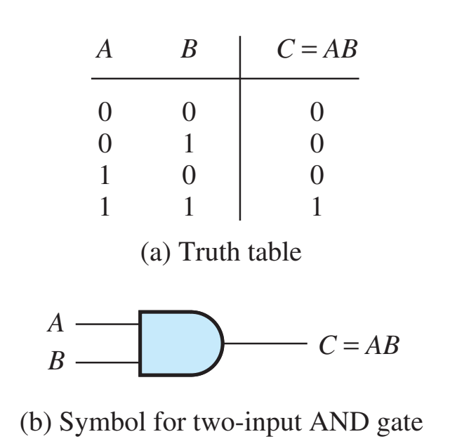
AND Gate
The AND operation on two logic variables, A and B, is represented as AB, read as “A and B.”
The AND operation is also called logical multiplication.

Slide 22
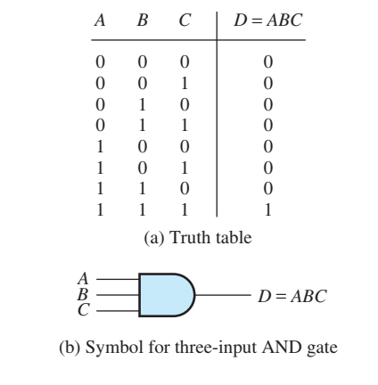
Three input and gate

Slide 23
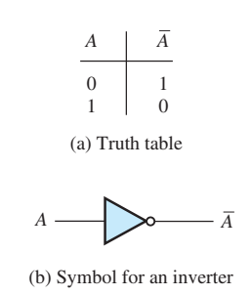

Not gate
The NOT operation on a logic variable is represented by placing a bar over the symbol for the logic variable. The symbol $\overline{A}$ is read as “not A” or as “A inverse.” If A is 0, $\overline{A}$ is 1, and vice versa.

Slide 24
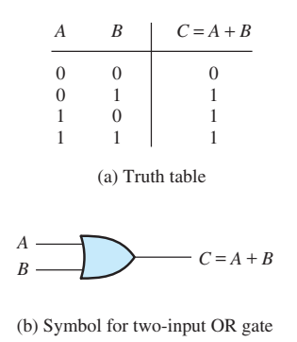
Or gate
The OR operation of logic variables is written as A+B, which is read as “A or B.”
Notice that A+B is 1 if A or B (or both) are 1.
The OR operation is also called logical addition.

Slide 25
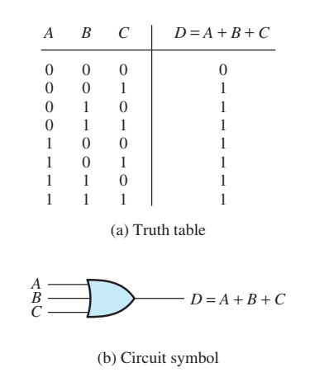
Three-input OR gate

Slide 26
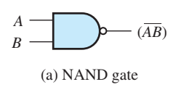
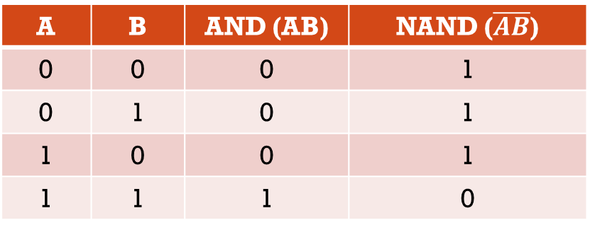
Nand gate
The NAND gate is equivalent to an AND gate followed by an inverter.
Notice that the symbol is the same as for an AND gate, with a bubble at the output terminal to indicate that the output has been inverted after the AND operation.
A | B | AND (AB) | NAND ($\overline{AB}$)
0 | 0 | 0 | 1
0 | 1 | 0 | 1
1 | 0 | 0 | 1
1 | 1 | 1 | 0

Slide 27
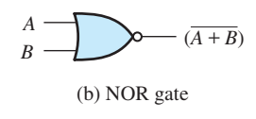
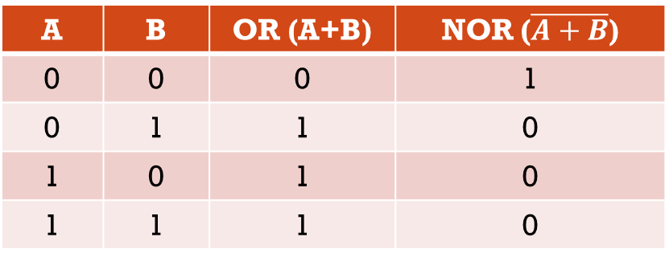
Nor gate
Similarly, the NOR gate is equivalent to an OR gate followed by an inverter.
A | B | OR (A+B) | NOR ($\overline{A+B}$)
0 | 0 | 0 | 1
0 | 1 | 1 | 0
1 | 0 | 1 | 0
1 | 1 | 1 | 0

Slide 28
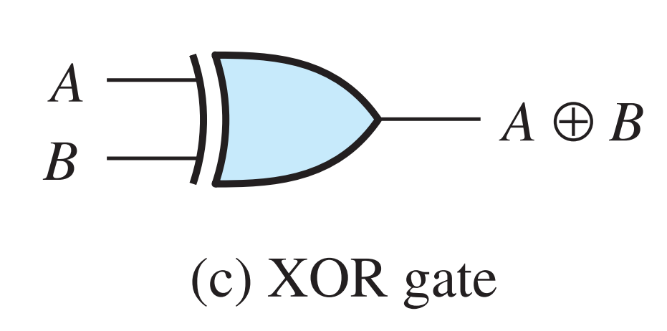

Xor gate
A⊕B = A$\overline{B}$+$\overline{A}$B
The exclusive-OR (XOR) operation for two logic variables A and B is represented by A ⊕ B and is defined by
0 ⊕ 0 = 0
1 ⊕ 0 = 1
0 ⊕ 1 = 1
1 ⊕ 1 = 0
Notice that the XOR operation yields 1 if A is 1 or if B is 1, but yields 0 if both A and B are 1. The XOR operation is also known as modulo-two addition.
A | B | XOR
0 | 0 | 0
0 | 1 | 1
1 | 0 | 1
1 | 1 | 0

